Slide 1
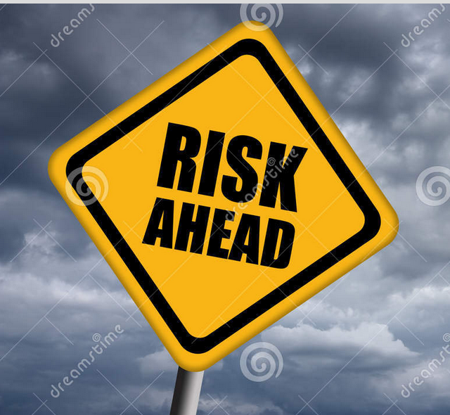
ReachOut 2021
Talk Two
Risks in God’s Mission
12th September

Slide 2

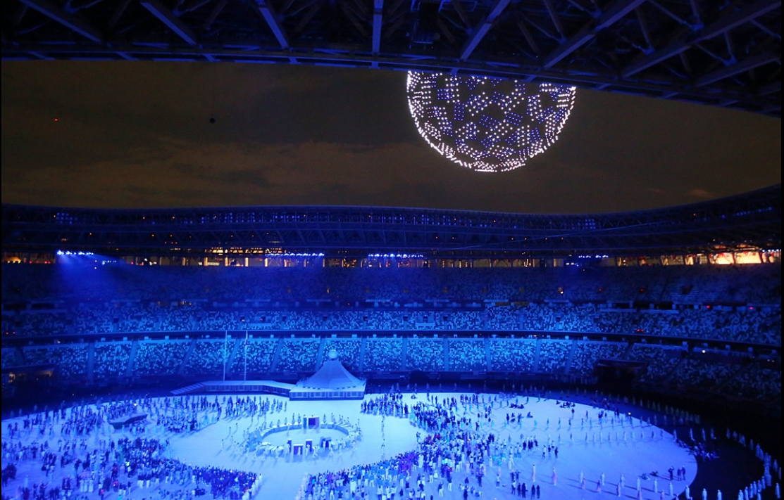
Should we hold it?
Should we not hold it?
Risk averse
vs
Risk taking

Slide 3
1. Risk-taking for Missions Between the Times (Luke 21:9-19)
a. We live in times of uncertainty and suffering (v9-11)
v9,10: revolutions and wars between nations
v11: earthquakes, famines, pestilences
VUCA world - volatility, uncertainty, complexity, ambiguity
John Piper “Risk is woven into the fabric of our finite lives. We cannot avoid risk even if we want to.” He warns of “the myth of safety” and “the enchantment of security, which is a mirage. It does not exist.”

Slide 4
1. Risk-taking for Missions Between the Times (Luke 21:9-19)
b. We as believers will experience additional suffering (v12, 16, 17)
* Hatred, persecutions, imprisonment and death
Mark 10:30 “and with them persecution”
Ajith Fernando: 18x in NT joy & suffering found together
John 16:33 “In this world you will have trouble. But…”
1 Peter 4:12 “fiery ordeal… as though something strange”

Slide 5
1. Risk-taking for Missions Between the Times (Luke 21:9-19)
c. We are witnesses in this VUCA world (v13)
V13 “This will be our opportunity to bear witness” (ESV)
Crisis (危機) = risk (危) and opportunity (機)
William Godwin on “Redeeming Risk”
“Risk is not entirely negative ... to be removed, reduced or mitigated.”
“Risk is defined by both threat and opportunity in a relationship of creative tension.”

Slide 6
1. Risk-taking for Missions Between the Times (Luke 21:9-19)
d. We are called to take risks for the gospel (v14,15,18,19)
Acts 15:5 Leaders for the early church
Romans 16:3 Priscilla and Aquila
Phil. 2:27, 30 Epaphroditus
v9 “Do not be frightened”
v14, 15 “Do not worry beforehand…”
v18,19 “Not a hair of your head will perish. By standing
firm you will gain life.”

Slide 7
The journey of faith

Slide 8
2. Risk and Missions
Luke 14:25-35
Risks because we are called to serve in more dangerous/less developed contexts
• Higher risks of traffic accident
• Higher risks of violent robbery
• Higher risks of illness due to air pollution/unclean water
• Higher risks to health because of poorer healthcare
• Higher risk of natural disasters and poor infrastructure

Slide 9
2. Risk and Missions
b. Risks because of our testimony to Christ and
opposition to it
• Risk of hostility, rejection, even violence, because we
are foreigners and we share the gospel
• Risk of struggling with bribery, corruption and injustice
• Risk of governments criminalizing our work as
proselyting the locals or as blasphemy.
Resulting in increased risk of suspicion, hostility, surveillance, arrest, detention, deportation or death

Slide 10
2. Risk and Missions
c. Risks because of the stresses of cross-cultural
ministry - “cross-cultural risk”
• Risks of physical danger because of nationality or ethnicity
• Risks to mental health because of the extra stresses
• Risks to our families because of the stress of separation,
limited educational options, etc.
• Risk of conforming to local culture, values, politics, religion
• Risk of failing to learn the language, seeing fruits from
ministry or having adequate financial support
• Risk of not coping with serving in a multicultural and
intergenerational team

Slide 11
3. Paul’s Response to Risk
a. Risks as threats in Acts –> risk avoidance
•Acts 9:23-25 – Damascus
– Conspiracy to kill -> went to Jerusalem
•Acts 9:29-30 – Jerusalem
– Conspiracy to kill -> went to Caesarea and then Tarsus
•Acts 14:5-7 - Iconium
– Plot to attack/stone -> fled to Lystra
•Acts 17:5-10 – Thessalonica
– Mob/riot/arrest -> sent to Berea
•Acts 17:13-15 – Berea
– Agitated crowds -> sent to Athens
•Acts 19:23-20:1 – Ephesus
– Riot -> went to Macedonia

Slide 12
3. Paul’s Response to Risk
b. Risks as opportunities in Acts –> risk embraced
•Acts 14:2-3 – Iconium
– Stirred up and poisoned minds against them
-> so spent considerable time there, speaking boldly
•Acts 16:16-40 – In prison in Philippi
– Earthquake -> stayed and shared gospel with warden,
demanded public apology from officials
•Acts 19:27-20 –Ephesus
– Riot -> saw an opportunity in the crowd so Paul
preached to the large audience
•Acts 20:22-23 – 21:11-13 – In Ephesus, Caesarea
– warned by Holy Spirit, Agabus, brethren in Caesarea
and team members -> went to Jerusalem anyway

Slide 13
4. Perspectives on Risks in Missions
a. Keep in mind our highest calling
* Our highest calling - sharing the good news of Jesus Christ in all its fullness with the unreached and unengaged peoples in the world
* How - through our lives, our words, our actions and relationships as disciples of Jesus whose faith impacted all areas of our lives and who make similar disciples of Jesus

Slide 14
4. Perspectives on Risks in Missions
b. Be flexible and persevere
* Paul clearly refuses to give up on the overall mission of taking the gospel to the Gentiles while being ready to be flexible about how that is worked out
* For Paul, risk and perseverance went together
* OMF values states that “We are passionate to reach the unreached”, by “taking prayerful risks and persevering with the task that God has given us.”

Slide 15
4. Perspectives on Risks in Missions
c. Be aware of overly risk averse
* Hudson Taylor is said to have written “Unless there is an element of risk in our exploits for God, there is no need for faith.”
* Hudson Taylor refused to be satisfied with settling in the safer treaty ports but pressed to go inland. There were many risks and at times missionaries paid the cost.

Slide 16
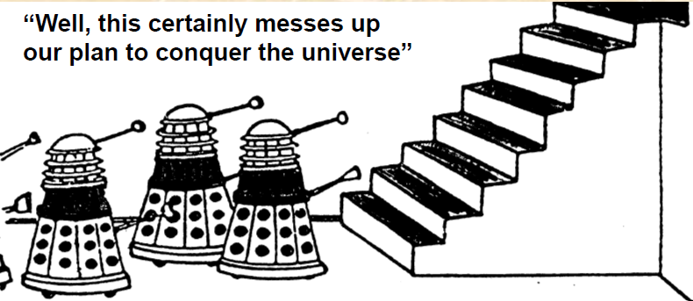
4. Perspectives on Risks in Missions
d. Apply Risk Assessment Process
* Risk Management is not about avoiding all risk
* It is about trying to ensure that we achieve our
goals through:-
- reducing unnecessary risk
- being ready for unavoidable risk

Slide 17
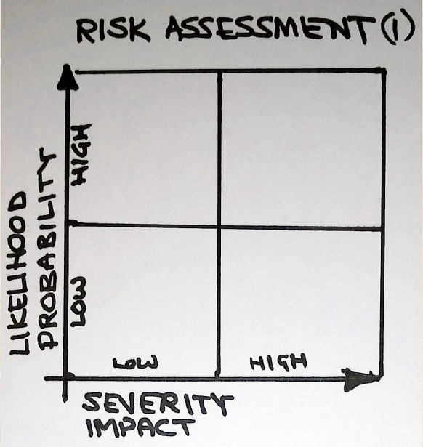
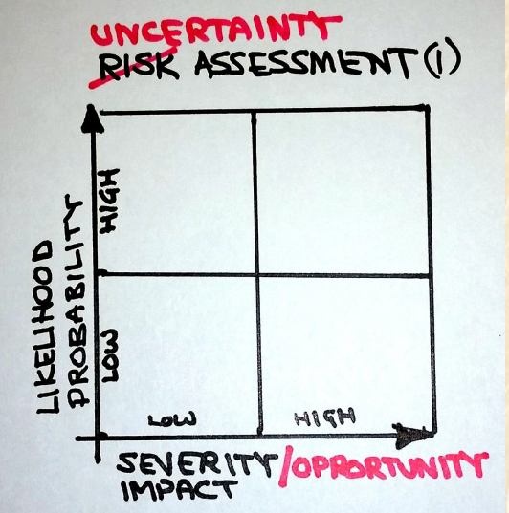
4. Perspectives on Risks in Missions
d. Apply Risk Assessment Process
a) Risk identification b) Risk analysis

Slide 18
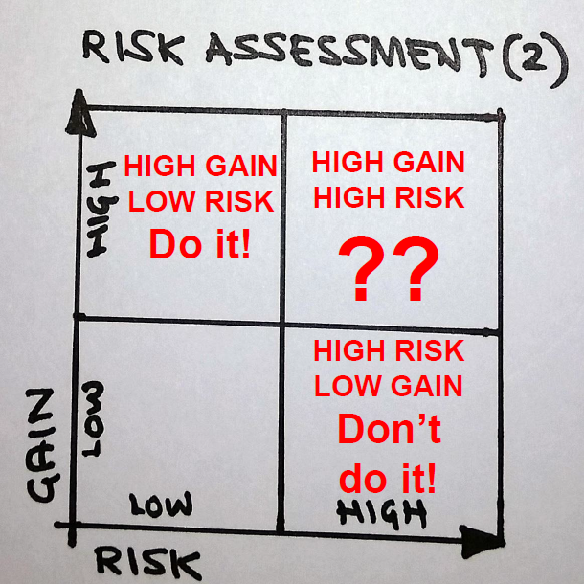
4. Perspectives on Risks in Missions
d. Apply Risk Assessment Process
c) Risk evaluation

Slide 19
4. Perspectives on Risks in Missions
e. Concern for impact on local believers
Example: Acts 16:37 Paul in Philippi
* What does it look like to the local people if we are always running scared? What are we teaching the young church when we pull our workers out of these risks?
* Our presence as foreigners should not endanger the safety of the local believers

Slide 20
Conclusion
Worth the Risk
Ralph Winter often said: “Risks are not to be evaluated in terms of the probability of success, but in terms of the value of the goal.”
The bigger risk (compare to our personal risk) is that the unreached will not hear the good news of Jesus Christ.
Acts 20:24 Paul’s testimony - “I consider my life worth nothing to me; my only aim is to finish the race and complete the task the Lord Jesus has given me—the task of testifying to the good news of God’s grace.”

