Slide 1
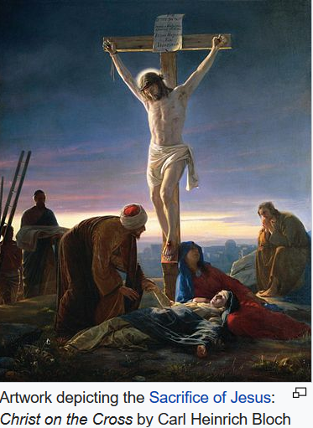
ReachOut 2021
Talk One
Sacrifices for God’s Mission
11th September

Slide 2
Acts 1:8
The Great Commission
“But you will receive power when the Holy Spirit comes on you, and you will be my witnesses in Jerusalem, and in all Judea and Samaria, and to the ends of the earth.”

Slide 3
a. Is the Great Commission
still relevant today?
According to the data by Travelling Team, a US agency mobilising university students for missions:
42% of the world population in
6,740 people groups (3.14 billion)
are still unreached with
less than 2% evangelical Christians
(http://www.thetravelingteam.org/stats)

Slide 4
b. Why is the Great Commission
not yet fulfilled?
* Very few churches are fully involved in missions ~ 900 churches for each unreached people group; but only about 10% of churches see missions as priority
* Very few Christians are missional Christians ~ 25% of professed Christians (2.2 billion) are practising Christians; of these only ~10% are world Christians. Hence only 2.5% of all professed Christians are missional Christians.

Slide 5
b. Why is the Great Commission
not yet fulfilled?
* Very few workers in the mission field
~ 430,000 cross-cultural workers/2.2 billion (only 0.02% of professed Christians)
4. Very little resources released for missions of all the giving for Christian causes, only 6.4% are given towards missions. Of this, only 1% went to the unreached
http://www.thetravelingteam.org/stats

Slide 6
c. Why are so few Christians responding to the call for missions?
“The harvest is plentiful but the workers are few”
(Matt. 9:37)
FOMS (Fear of Missions)
Sacrifices - what we have to leave behind or give up or face in order to respond to God’s call to mission
Risks-= threats and dangers we have to embrace in fulfilling God’s mission

Slide 7
1. Hesitancy for Missions
“The Life of I” by Anne Manne
Publisher: ReadHowYouWant
(2015)
- A compelling account of the rise of narcissism in individuals and society
- “A new narcissistic character-type is being fuelled by a cult of the self in a world where love and care are turned wholly inward.”

Slide 8
a. Self-inadequacy
Classic example: Moses’ excuses
His identity Exodus 3:11 “Who am I?”
His knowledge of God Exodus 3:13 “What is His name?”
His acceptance Exodus 4:1 “What if they do not
believe me or listen to me?”
His own ability Exodus 4:10 “What if I can’t speak
eloquently?”
His own reluctance Exodus 4:13 “O Lord, please send
someone else to do it.”

Slide 9
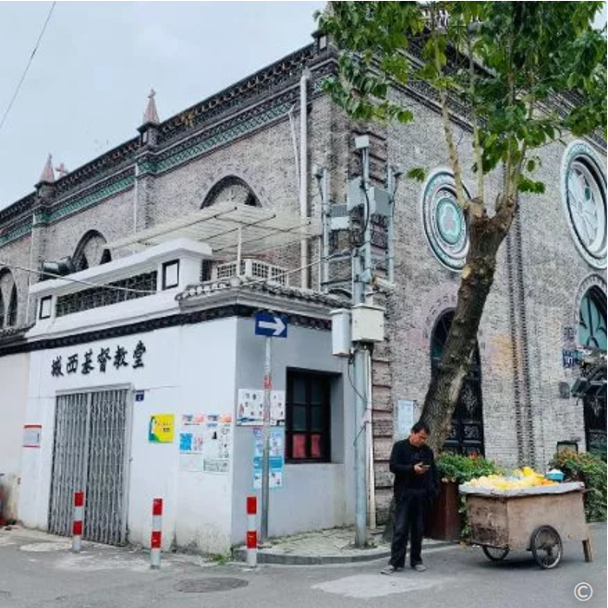
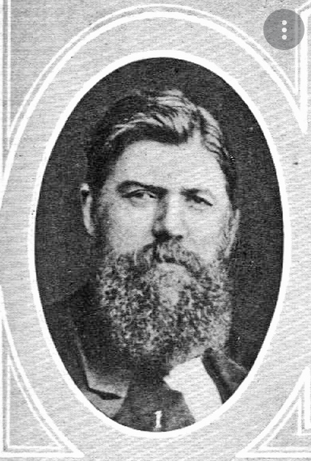
a. Self-inadequacy
George Stott (1835-1889)
“I do not see those with two legs going, so I must.”
Chengxi Christian Church (城西基督教堂)

Slide 10
b. Self-centreness
2 Timothy 3:1-5
¹ But mark this: There will be terrible times in the last days. ² People will be lovers of themselves, lovers of money, boastful, proud, abusive, disobedient to their parents, ungrateful, unholy, ³ without love, unforgiving, slanderous, without self-control, brutal, not lovers of the good, ⁴ treacherous, rash, conceited, lovers of pleasure rather than lovers of God— ⁵ having a form of godliness but denying its power. Have nothing to do with such people.

Slide 11
Luke 9:57-62
The Cost of Following Jesus
⁵⁷ As they were walking along the road, a man said to him, “I will follow you wherever you go.”
⁵⁸ Jesus replied, “Foxes have dens and birds have nests, but the Son of Man has no place to lay his head.”
⁵⁹ He said to another man, “Follow me.”
But he replied, “Lord, first let me go and bury my father.”
⁶⁰ Jesus said to him, “Let the dead bury their own dead, but you go and proclaim the kingdom of God.”
⁶¹ Still another said, “I will follow you, Lord; but first let me go back and say goodbye to my family.”
⁶² Jesus replied, “No one who puts a hand to the plow and looks back is fit for service in the kingdom of God.”

Slide 12
Luke 14:16-20
The Parable of the Great Banquet
¹⁶ Jesus replied: “A certain man was preparing a great banquet and invited many guests. ¹⁷ At the time of the banquet he sent his servant to tell those who had been invited, ‘Come, for everything is now ready.’
¹⁸ “But they all alike began to make excuses. The first said, ‘I have just bought a field, and I must go and see it. Please excuse me.’
¹⁹ “Another said, ‘I have just bought five yoke of oxen, and I’m on my way to try them out. Please excuse me.’
²⁰ “Still another said, ‘I just got married, so I can’t come.’

Slide 13
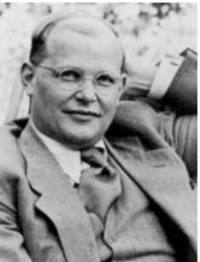
2. Sacrifice we may be called to make a. Sacrifices we are to make as disciples
“The Cost of Discipleship”
By Dietrich Bonhoeffer
“Cheap grace is grace without discipleship, grace without the cross, grace without Jesus Christ, living and incarnate.
Costly grace confronts us as a gracious call to follow Jesus. It is costly because it calls us to follow, and it is grace because it calls us to follow Jesus Christ.”

Slide 14
2. Sacrifice we may be called to make a. Sacrifices we are to make as disciples
* Offer our bodies as a living sacrifice (Romans 12:1)
* Continually offer to God a sacrifice of praise and
confession of His name (Hebrews 13:15)
* Give up our rights in view of the Lordship of Christ
* Adopt a counter culture mindset (Romans 12:2)
‘Do not conform to the patterns of this world’

Slide 15
2. Sacrifice we may be called to make b. Sacrifices we make for going to another place
* Leaving our comfort zone and support base
* Leaving our family and loved ones
* Leaving our parents without their grandchildren
* ‘Sacrificing’ the future of our children
* Leaving behind friendships

Slide 16
2. Sacrifice we may be called to make c. Sacrifices we make as servants of the
gospel cross-culturally
* Giving up on potential opportunity to get married
* Leaving behind professional advancement
* Leaving behind financial security and a certain future
* Leaving behind angry or disappointed parents
* Leaving our established roles, identity or fruitful
ministries
* Losing face and independence because of support
raising

Slide 17
3. Self-sacrificing: Jesus and Missions
Someone says, “We will take sacrifice seriously only if we understand the cross.”
In Philippians 2:6-11, we have one of the hymns sung by the early church.

Slide 18
Philippians 2:6-9
A Seven-Step Descending Process
V6 Christ, who being in the very nature God,
1
did not consider equality with God something to be grasped
2
but make himself nothing,
taking the very nature of a servant,
3
Being made in human likeness. And being found in appearance as a man,
4
5
He humbled himself
6
and became obedient to death -
7
even death on a cross.

Slide 19
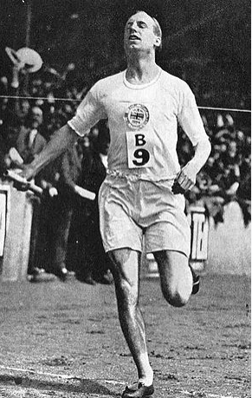
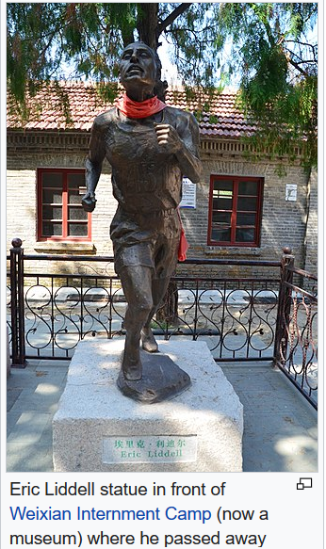
3. Self-sacrificing: Eric Liddell (1902-1945)
His last words:
“It’s complete
surrender.”

Slide 20
4. Perspectives on Sacrifices
God’s unchanging purpose
Chris Wright (2006)
“God’s unchanging mission is bringing people to Himself through God’s people.”

Slide 21
4. Perspectives on Sacrifices
b. Lordship of Christ
Hudson Taylor:
“If He is not the Lord of all, He is not the Lord at all.”

Slide 22
4. Perspectives on Sacrifices
c. Gracious Hand of God
John 1:16 “From the fullness of His grace, we have all received grace upon grace.”
1 Corinthians 15:10a “But by the grace of God I am what I am, and His grace to me was not without effect.”
Psalm 103:2, “Forget not His multiple, varied graces.”
This phrase, “the gracious hand of God” is found in Ezra (5x) and Nehemiah (2x).

Slide 23
4. Perspectives on Sacrifices
d. Momentary sufferings → Eternal Glory
Hebrews 12:2
“Let us fix our eyes on Jesus… who for the joy set before Him endured the cross, scorning its shame and set down at the right hand of the throne of God.”
2 Cor. 4:17,18, ‘Our light and momentary troubles are achieving for us an eternal glory that far outweighs them all. So we fix our eyes not on what is seen, but on what is unseen. For what is seen is temporary, but what is unseen is eternal.“

Slide 24
Conclusion
Are you willing to be a fool for Christ?
Jim Elliott “He is no fool who gives what he cannot keep to gain what he cannot lose.”
Hudson Taylor “All God’s servants are ordinary people with an extraordinary God.”
Matt. 28:20 “And surely I am with you always to the very end of the age.”

